Slide 1
PhatChat: Week 3
stazer1336@googlemail.com

Slide 2
Table of Contents
Accomplishments
Ping-Pong Concept
Connection Window
Goals for next Week
Chat Window
Message and Username Handling

Slide 3
Accomplishments
Ping-Pong Concept
Server sends every 5 seconds ping packets with the current timestamp as value to all connected clients
Client receives ping packet and responds with pong packet
Server receives the pong packet

Slide 4
Accomplishments
Connection Window
Used to connect to a server
pops up on client startup (except for the case when three command line arguments are used (username, host address, port))
pops up if connection to server is closed or the chat window is closed
Notes:
sockets = port number + ip address of the machine, FLTK “FULLTICK”

Slide 5
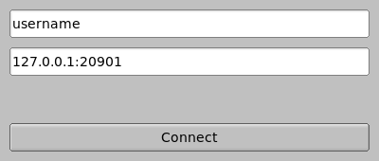
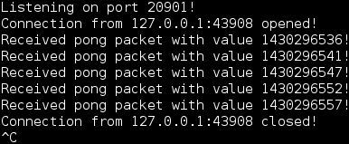
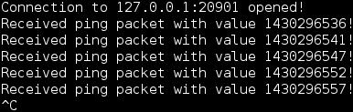

Accomplishments

Slide 6
Goals for next week
Chat Window
used to show all chat messages
used to send messages from the user
graphical representation

Slide 7
Goals for next Week
Message and Username Handling
implement message packets and response username and request username packets
handle new packets
connect network with graphical user interface

